Slide 1





A Mixed-Methods Study of Mobile Users’ Data Usage Practices in South Africa
Arunesh Mathur, Brent Schlotfeldt, Marshini Chetty

Slide 2
I study how people use the Internet and create tools to help them manage different aspects of their Internet experience.

Slide 3

Internet Performance
Internet Data Management
Usable Security Online
Internet Constraints

Slide 4
Are you checking email on your smart phone right now or still listening to this talk?

Slide 5
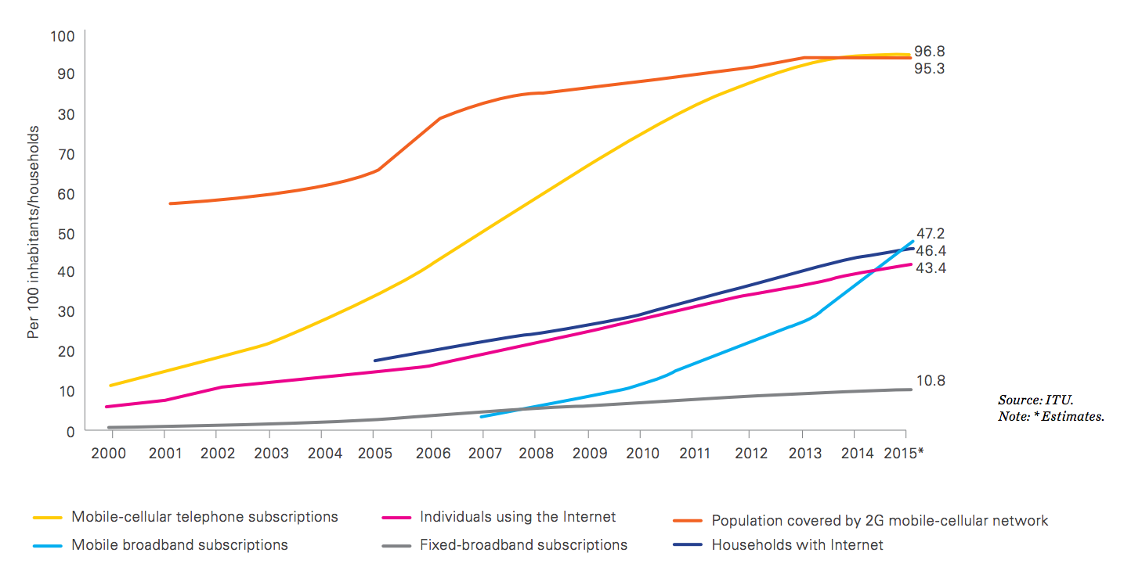
Mobile broadband is most dynamic market segment; globally mobile broadband penetration reaches 47% in 2015, a value that has increased 12 times since 2007 (Source: ITU ICT Facts and Figures 2015)

Slide 6

Africa has 35 times as many mobile broadband subscriptions per 100 inhabitants vs fixed broadband subscriptions (Source: ITU ICT Facts and Figures 2015)
Notes:
Also faster and easier to get set up

Slide 7
Globally, mobile data usage is predicted to increase tenfold by 2019
(Source: Cisco Visual Networking Index: Global Mobile Data Forecast Update 2014-2019)

Slide 8

Image from Flickr: @quinnanya

Slide 9
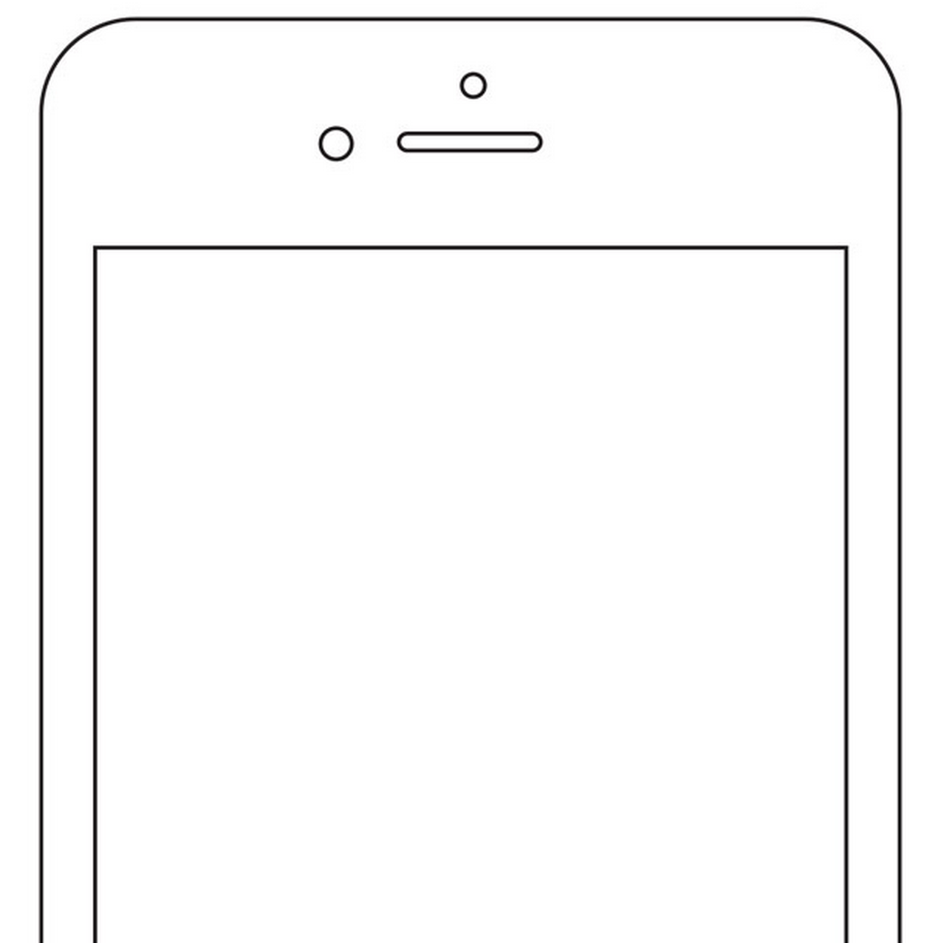

You have used your 1GB of mobile data. Your Internet speeds will be slower until until your next billing cycle starts and you will be charged at a higher billing rate.

Slide 11
Research Goal
Determine how users manage and control different aspects of mobile data and find design implications for mobile data applications and data monitoring tools

Slide 12
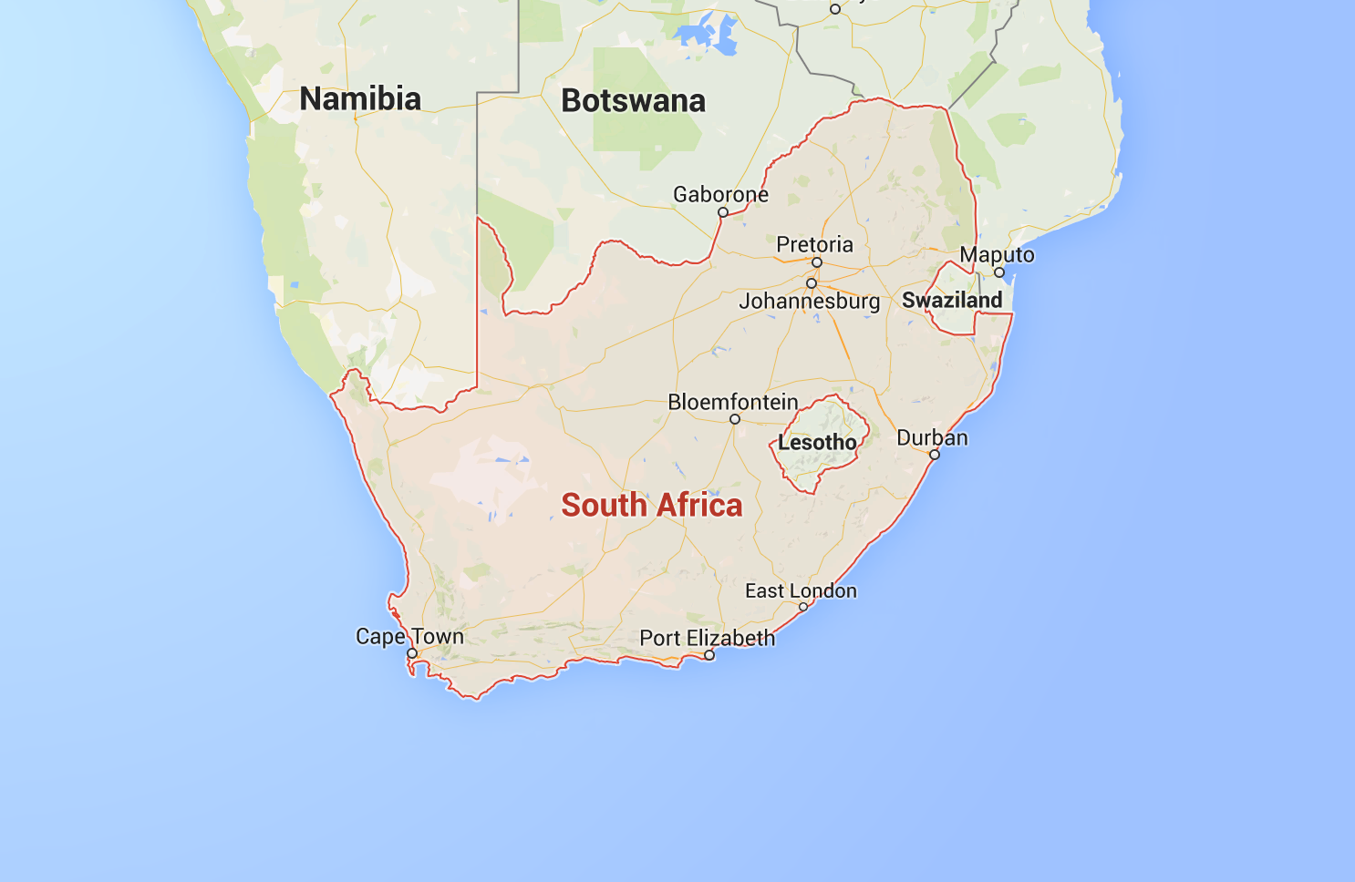

Slide 13
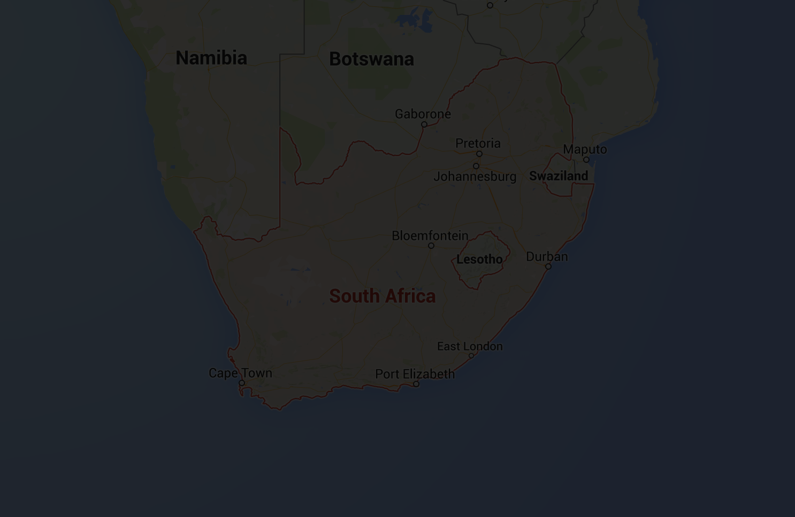
Less unlimited data

Slide 14
Less unlimited data
High data
costs

Slide 15

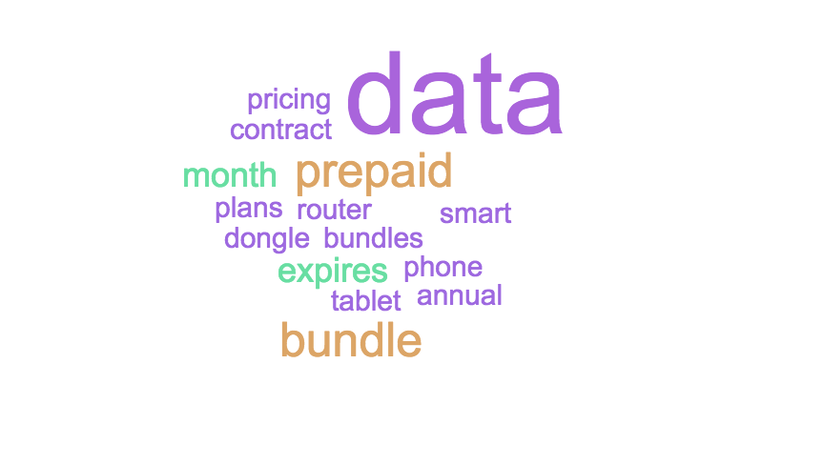


Slide 16

I’m confused – Brian Moore (https://www.flickr.com/photos/doctabu/342220423/)

Slide 17
Research Questions

Slide 18

Research Questions
Q1: How does the cost of mobile data affect usage?
Q2: Do users know which apps consume most data on their mobile phones?
Q3: How and using what tools do users track mobile data?

Slide 19

Research Questions
Q1: How does the cost of mobile data affect usage?
Q2: Do users know which apps consume most mobile data on their mobile phones?
Q3: How and using what tools do users track mobile data?

Slide 20

Research Questions
Q1: How does the cost of mobile data affect usage?
Q2: Do users know which apps consume most mobile data on their mobile phones?
Q3: What tools do users employ to track mobile data?
Notes:
What are design implications for mobile applications and mobile tools?

Slide 21
Research Method

Slide 22

Research Method

Slide 23

Research Method
Online Survey (N = 339)

Slide 24

Research Method
Online Survey (N = 339)
Semi-structured Interviews
(N = 43)

Slide 25
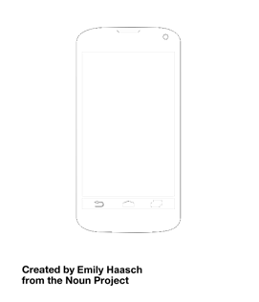
Research Method
Online Survey (N = 339)
Semi-structured Interviews
(N = 43)
MySpeedTest (N = 121)

Slide 26
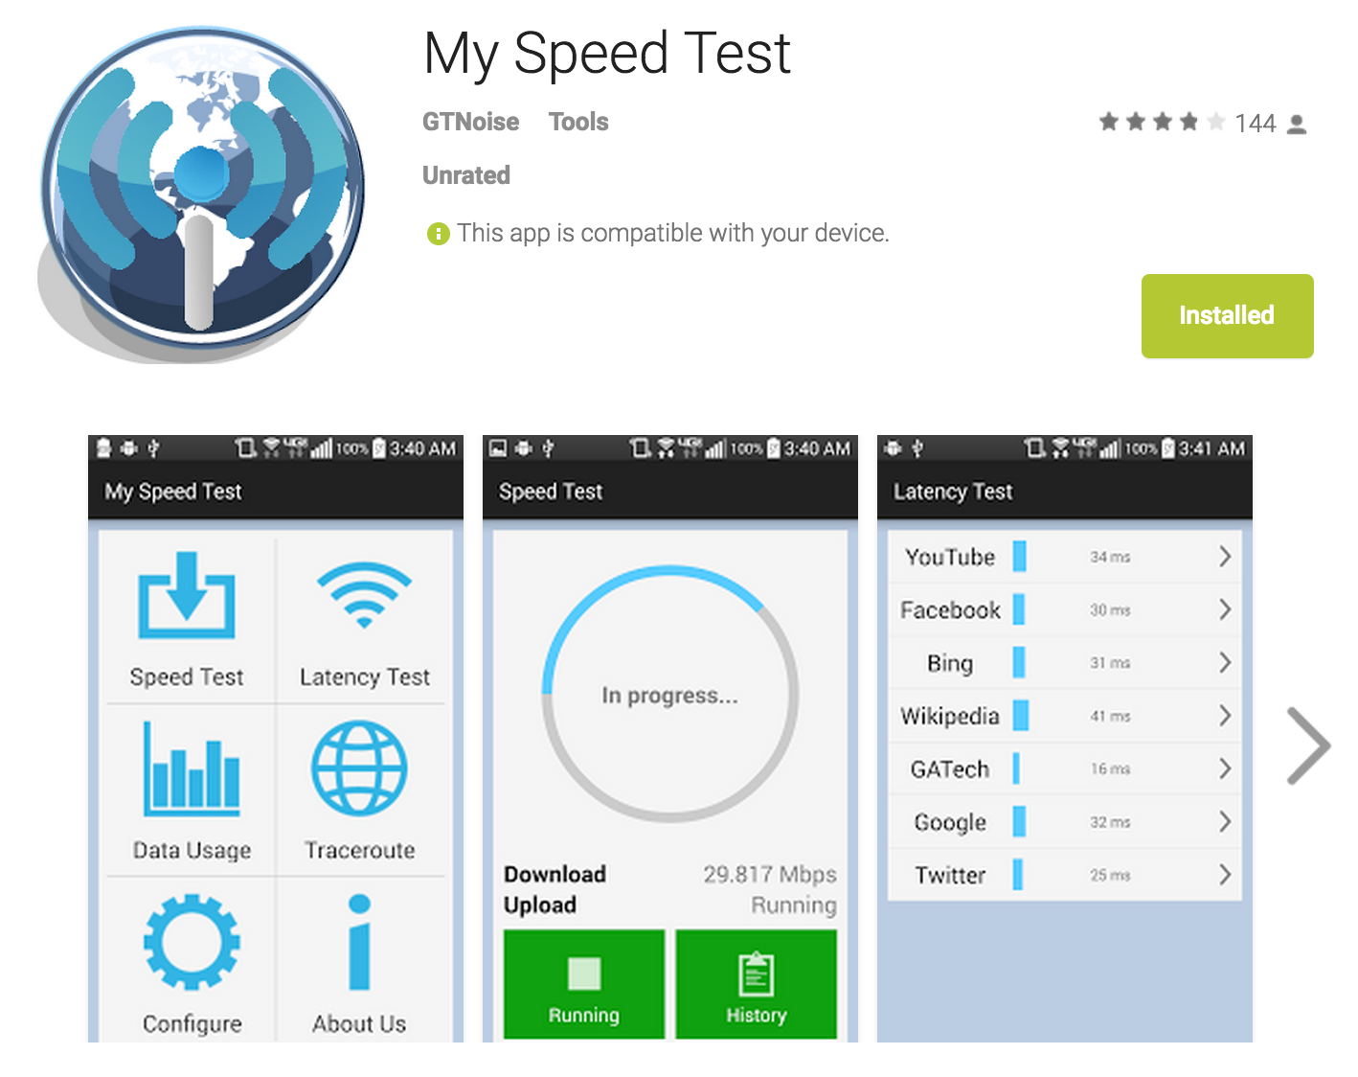

Slide 27


Slide 28
Research Method
Research Method
Participants
 | Low Income (N=119) | High Income (N=165) | Total (N=339)
Age |  |  | ¼ between 18-24 Rest 24+ years old
Gender |  |  | 81% male
Education | 51.3% had high school only | 61% had higher education degree
Connectivity @home | 58% on mobile broadband only and only 42% had fixed broadband at home | 35.2% on mobile broadband only and 64.8% had fixed broadband at home
Monthly median spending on mobile data | ~R135 | ~R165

Slide 29
Research Method
Research Method
Participants
 | Total (N=121)
Network Provider | 47% on Vodacom 25% on MTN 17% on Cell C Rest on 8ta/Telkom mobile/unknown
Phone Manufacturer | 81% Samsung

Slide 30
Findings
Q1: How does the cost of mobile data affect usage?
Q2: Do users know which apps consume most mobile data on their mobile phones?
Q3: What tools do users employ to track mobile data?

Slide 31
Findings
Q1: How does the cost of mobile data affect usage?
Q2: Do users know which apps consume most mobile data on their mobile phones?
Q3: What tools do users employ to track mobile data?

Slide 32

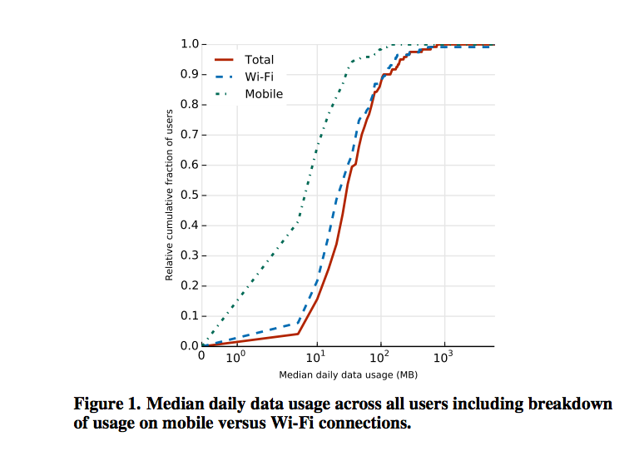
Mobile data is a high-value asset and costs dictate users’ choice of Internet plans
90% of MySpeedTest
users use less than
100 MB per day
Users use twice as
much data on WiFi
Optus Prepaid- Zachary Phua (https://www.flickr.com/photos/54775905@N04/6363092169)
Notes:
35% low income, 49% high income, rest no income reported
Mostly male (81%)
Low income users (58%) only had high school education whereas more high income had higher education degrees (61%)
58% of low income users had mobile broadband only compared to 35.2% of high income users
More high income users had fixed line broadband (64.8%) than low income (42%)
Median monthly
90% of MySpeedTest users had less than 100 MB per day
Only 15% less than 10 MB a day
Twice as much on WiFi than mobile

Slide 33


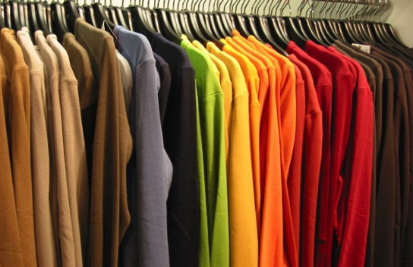
Low-income users ranked mobile data higher than:
Education
Health
Clothing

Slide 34
I cut down on my hair products; I wash my hair once every two weeks to save money for data.
- P21
“”
“

Slide 35

Users frequently disconnect from the mobile Internet to save data
Unplugging the Machine - Chris Phan (https://www.flickr.com/photos/54458860@N00/2271647729)

Slide 36
I keep my data connection on when I’m chatting or messaging, but when I’m busy, I put it off.
- P10
“”
“

Slide 37
Findings
Q1: How does the cost of mobile data affect usage?
Q2: Do users know which apps consume most mobile data on their mobile phones?
Q3: What tools do users employ to track mobile data?

Slide 38
Findings
Q1: How does the cost of mobile data affect usage?
Q2: Do users know which apps consume most mobile data on their mobile phones?
Q3: What tools do users employ to track mobile data?

Slide 39

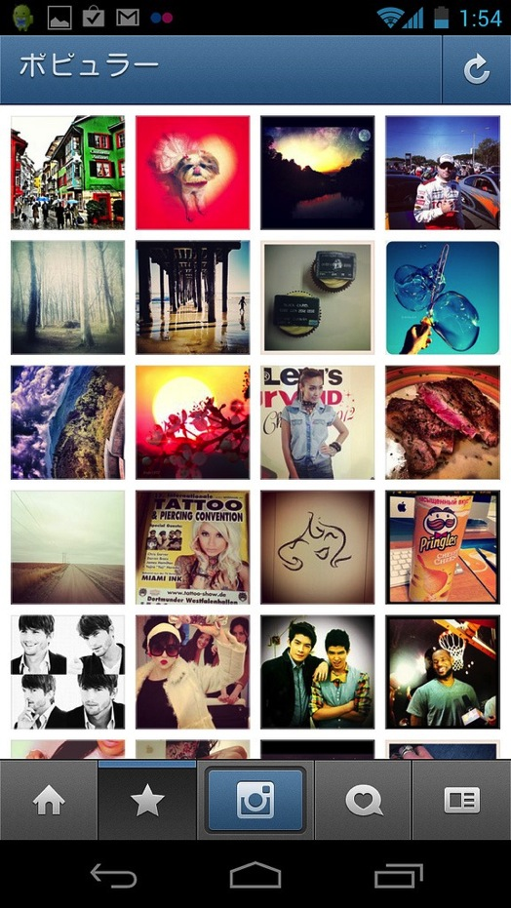

Users knew multimedia applications consumed most data and avoided them
84% knew watching a 10 minute video consumed more data than using social media or reading text article for same amount of time

Slide 40
When it comes to streaming of things from YouTube, stuff like that, I know that takes a lot of data.
- P14
“”
“

Slide 41

However, they found it hard to interpret invisible consumers
Active Notifications - Theus Falcao (https://www.flickr.com/photos/theusfalcao/9563767145)

Slide 42
I don’t understand how Facebook Messenger. I think it’s off and then all of a sudden you just notice the chat comes on.
- P29
“”
“

Slide 43
MySpeedTest
Decreasing order of median daily data usage

Slide 44


MySpeedTest: Overall Data Usage
YouTube
#25
Skype
#27

Slide 45
MySpeedTest: Mobile Data
{
6 of the top 10 applications using mobile data ran as background services

Slide 46



MySpeedTest: Mobile Data
Facebook
#1
}
Twitter
#6
WhatsApp
#10

Slide 47
MySpeedTest: Mobile Data
Facebook
#1
}
Twitter
#6
WhatsApp
#10

Slide 48
MySpeedTest: WiFi
{
5 of the top 10 applications on WiFi related to downloads + media storage (also background services)

Slide 49

MySpeedTest: WiFi
Facebook
#6
}
Twitter
#7
Google+
#10

Slide 50
Findings
Q1: How does the cost of mobile data affect usage?
Q2: Do users know which apps consume most mobile data on their mobile phones?
Q3: What tools do users employ to track mobile data?

Slide 51
Findings
Q1: How does the cost of mobile data affect usage?
Q2: Do users know which apps consume most mobile data on their mobile phones?
Q3: What tools do users employ to track mobile data?

Slide 52

Most users tracked usage by repeatedly viewing their data balances
Tools - Tontographer (https://www.flickr.com/photos/36247316@N00/3108399560)

Slide 53
I check my airtime balance and I will see. I know Facebook and Instagram takes most of the data. So I will use it on that, then I’ll check again.
- P10
“”
“

Slide 54
Others expressed displeasure with ISP provided data-tracking tools
57.4% reported tracking mobile data in survey but interviews revealed this was more pervasive
Tools - Tontographer (https://www.flickr.com/photos/36247316@N00/3108399560)

Slide 55
Optimizing strategies to save mobile data include purposefully disconnecting, postponing data usage, avoiding data-intensive applications, changing settings, and using special bundles.

Slide 56
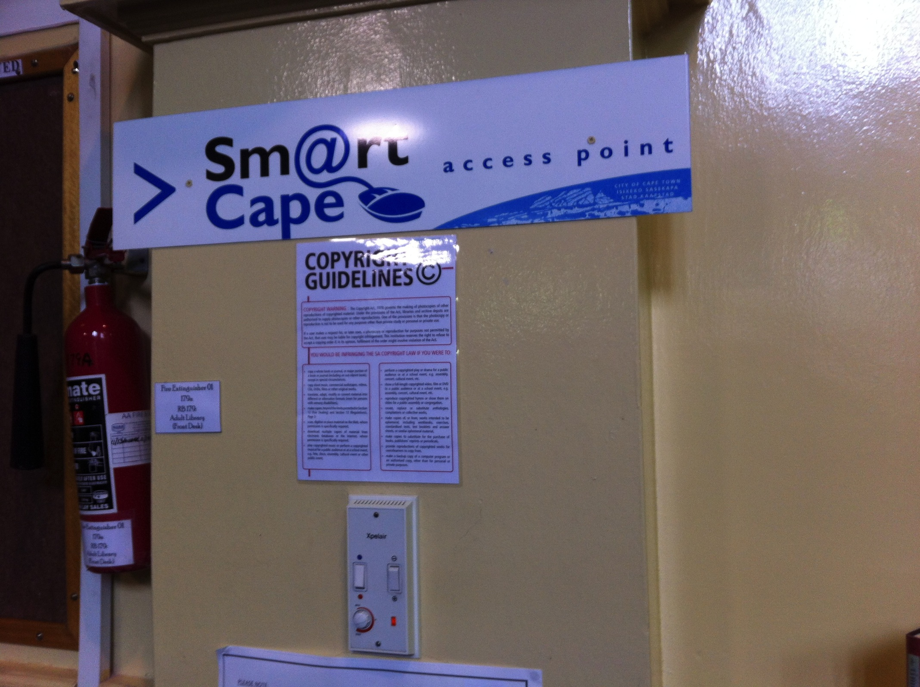

Slide 57
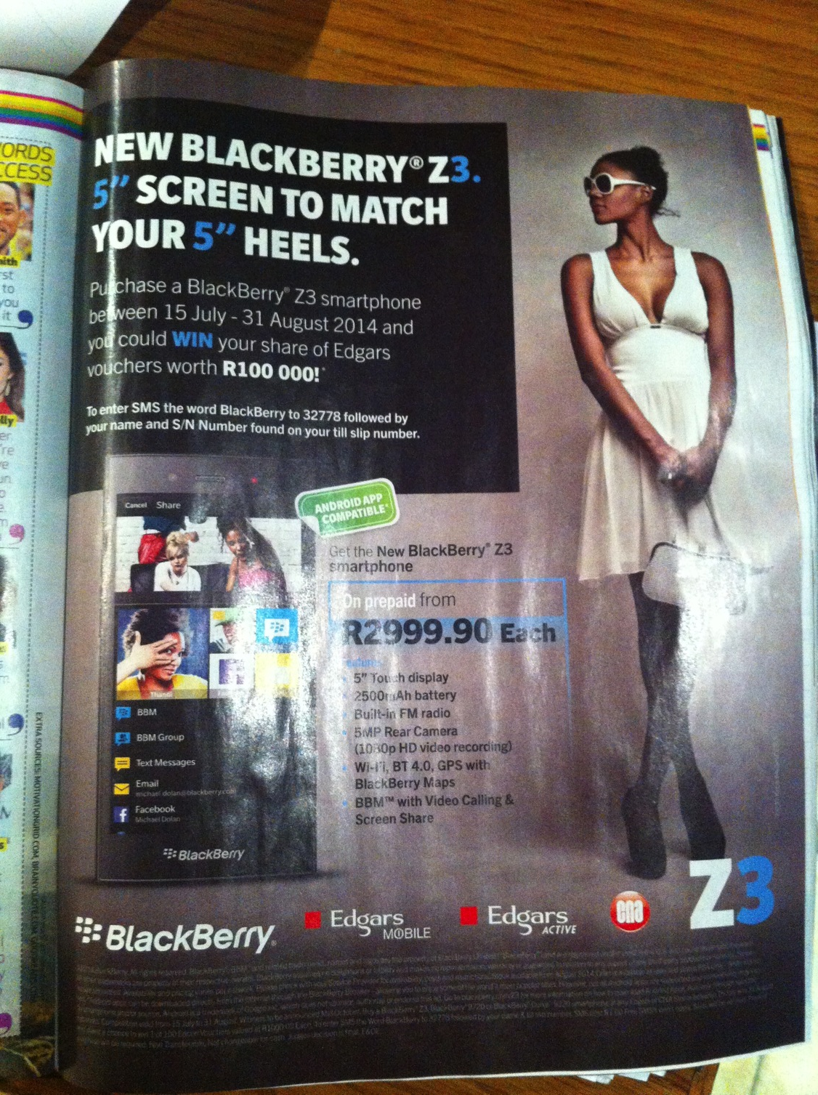

Slide 58

Users desired greater visibility and control into how much data different applications use
Close up person using smartphone - Japanexperterna.se (https://www.flickr.com/photos/68532869@N08/17471462035)

Slide 59
I want to be able to specify how much data I want a particular app to use in a particular month. So I want my WhatsApp application to be dedicated 20 MB worth of data every month.
- P29
“”
“

Slide 60
Findings
Q1: How does the cost of mobile data affect usage?
Q2: Do users know which apps consume most mobile data on their mobile phones?
Q3: What tools do users employ to track mobile data?

Slide 61
Implications for Design
Costs influence how users get online and often involves purposeful disconnection

Slide 62

Implications for Design
Costs influence how users get online and often involves purposeful disconnection
Reducing costs
(e.g. caching ads, zero-rating)
Support new interaction styles

Slide 63

Implications for Design
Costs influence how users get online and often involves purposeful disconnection
Reducing costs
(e.g. caching ads, zero-rating)
Support new interaction styles

Slide 64
Implications for Design
Users need improved mobile data management

Slide 65

Implications for Design
Users need improved mobile data management
Optimize, optimize, optimize!
Ensure apps behave the way users want them to

Slide 66

Implications for Design
Users need improved mobile data management
Optimize, optimize, optimize!
Ensure users know how apps behave

Slide 67
Implications for Design
Users seek greater control over data usage

Slide 68
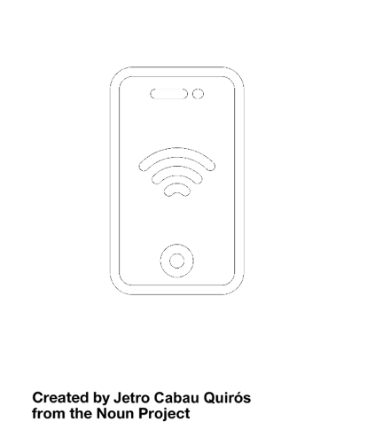
Implications for Design
Users seek greater control over data usage
Improve existing data tracking tools

Slide 69

Implications for Design
Users seek greater control over data usage
Improve existing data tracking tools
VISA: Tool to help software devs test apps under different network conditions

Slide 70

Credits
Get in Touch:
{amathur, marshini}@umd.edu
@ineffablicious
Find Out More:
Ubicomp 2015 Paper http://goo.gl/KI4j5A
http://netchi.umd.edu/
Acknowledgements:
Andrew Kim and Miseon Park of Georgia Tech
Nick Feamster from Princeton University
MyBroadband
This work was supported by
Icons From The Noun Project:
Brennan Novak, Sarah Abraham, Emily Haasch, Scott Lewis, Julia Stoffer, Luis Prado, Jetro C Quirós, and Qing LI

