Slide 1
By T. Grandon Gill
Incorporating Evolutionary Fitness into Design Science

Slide 2
Overview
The design task and design science
The concept of fitness
Refocusing design outcomes
Conclusions

Slide 3
The Design Task and Design Science
What is “design science” and why should we care about it?

Slide 4
Three Worlds of Design
Representation & Symbols
Intuition and Experience
External Environment
Principal focus of design science → end point is design artifact
Real world determines ultimate success of the design artifact
Guides design through feelings and creativity → context driven

Slide 5
Design Cycle and Role of Design Science
Develop design candidates
Select design artifact
Artifact outcomes
Determine design constraints
Presents constraints
Intelligence
Formalized Processes
Creativity
Design
Real
World
Designer’s
Mind
Design Science
Estimates of Fitness
Choice
Utility
Fitness landscape

Slide 6
Fitness
Applying the concept of evolutionary fitness to design

Slide 7
Nature of Fitness
The success of a design can be characterized as its “fitness”
Two possible interpretations, inspired by biology:
  Fitness Deﬁnition #1. The ﬁtness of an organism describes its ability to survive at a high level of capacity over time.
  Fitness Deﬁnition #2. The ﬁtness of an organism describes its ability to reproduce—completely or in part—and evolve over successive generations.
Concepts are related, but can sometimes work against each other
  Example: population dynamics

Slide 8
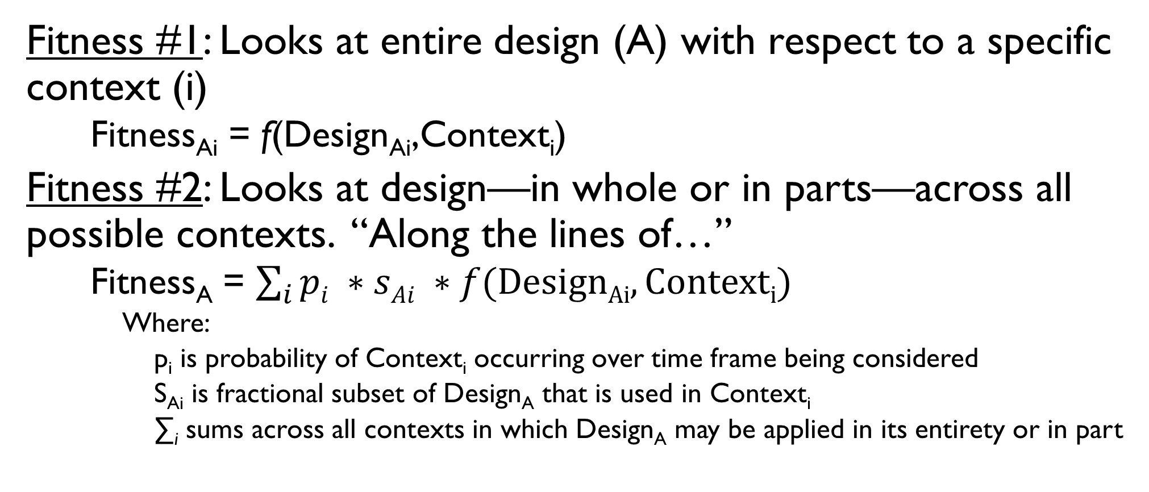
Interpretation in Design Context
Fitness #1: Looks at entire design (A) with respect to a specific context (i)
    Fitness_{Ai} = f(Design_{Ai},Context_{i})
Fitness #2: Looks at design—in whole or in parts—across all possible contexts. “Along the lines of…”
    Fitness_{A} = $\sum_{i}{pi ∗sAi ∗f(DesignAi,Contexti)}$
      Where:
        p_{i} is probability of Context_{i} occurring over time frame being considered
        S_{Ai} is fractional subset of Design_{A} that is used in Context_{i}
        ∑_{i} sums across all contexts in which Design_{A} may be applied in its entirety or in part

Slide 9
Fitness and Complexity
As components of a design interact, landscape becomes “rugged”.
  Example: ingredients in a recipe
Rugged landscape characteristics
  Many local peaks
  Sharp drop-offs
  General rules fail to apply
  Landscape dynamics tend towards punctuated equilibrium, making prediction less reliable
Implications
  Estimates of fitness (e.g., result of “science”) and intuition become weaker
  Status quo becomes increasingly attractive
  Imitation often yields better results than analysis
  Design science becomes irrelevant…?

Slide 10
Refocusing Design Outcomes
Emphasizing reproduction over fit to a specific context

Slide 11
Usefulness vs. Fitness
Fitness
Decomposable
Malleable
Open
Embedded in Design System
Too
Useful?
Useful
Novel
Interesting
Usefulness
Elegant

Slide 12
Effects of Fitness Characteristics
Decomposable
Promotes Modification
(Mutation, Recombination)
Malleable
Open
Embedded in Design System
Promotes Quality,
Consistency, Motivation
Novel
Promotes Diversity
Interesting
Promotes Diffusion
Elegant
Promotes Longevity

Slide 13
Conclusions
Why should we care about design fitness?

Slide 14
Benefits of Fitness Approach
In an increasingly complex environment, predicting usefulness based on an initial design becomes increasingly difficult
  Example: increasing acceptance of agile methodologies
Offers insights not necessarily self-evident (or, at least, justifications for insights)
Can be applied in a practical manner
Takes a longer-term view of design
  More suitable as a research focus given publication cycles
Offers many research opportunities
  Validating proposed design characteristics
  Cross-fertilization with other biologically-inspired research areas, such as genetic algorithms

